Slide 1
General thoughts and comments
Still a couple of views to add. Things I overlooked before but shouldn’t be too difficult to add in.
Most views are set up in onshape to fill one page and then I screenshotted and cropped to the page.
This affects the size of the dimension text when rescaled and I don’t know the solution to that.
1. Angle iron is not listed in the required materials
2. Pictures next to each of the materials would be ideal. Especially for the PVC end cap and angle iron. Maybe even a generic image from online?
3. For Step 2 how many times should I repeat the rotation?
4. Do I need a vice to hold parts for drilling?
5. Step 5 doesn't quite make sense. Maybe a typo?
7. Step 7 is excellent
8. What tool should be using to draw the lines in Step 7?
9. How do I work out the angles for step 9?
10. Step 15 could maybe do with a bit of breaking down? E.g do I tighten the nut first and then the coupling?

Slide 2
Tools required:
Cutting tool (hand saw/power saw)
Drill (preferably drill press and hand drill)
Spanner/wrench for M5 nuts/bolts
Materials | Quantity
90mm PVC pipe (1m length) | 1
100mm PVC end cap | 1
M5x25mm bolt | 10
M5 nylon locking nut | 10
M16x100mm bolt | 1
M16x60mm threaded coupling | 1
M16 nut | 1
Notes:
Would maybe be cool to have symbols for each tool and then use these to describe each operation. E.g. instead of saying ‘cut blades’, show symbol of cutting tool next to drawing of dimensions to be cut.

Slide 3
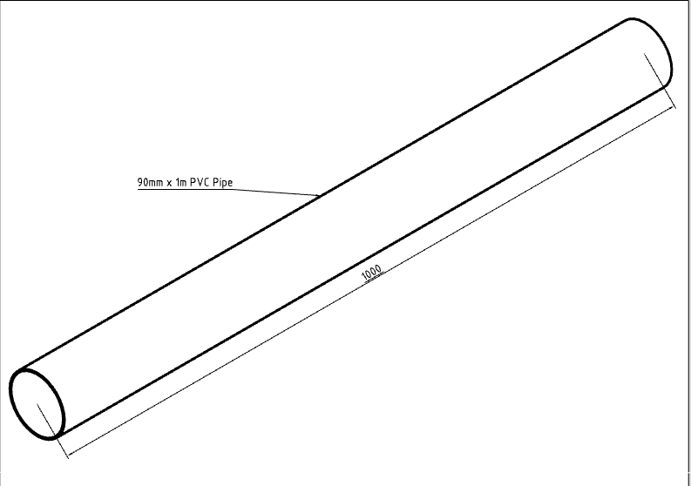
PVC can be a great material to make wind turbine blades. It is cheap, light and readily available at most hardware stores. To make blades that are 500mm long, you will want to start with a 1m length of 90mm PVC, which is approximately 2mm thick.

Slide 4
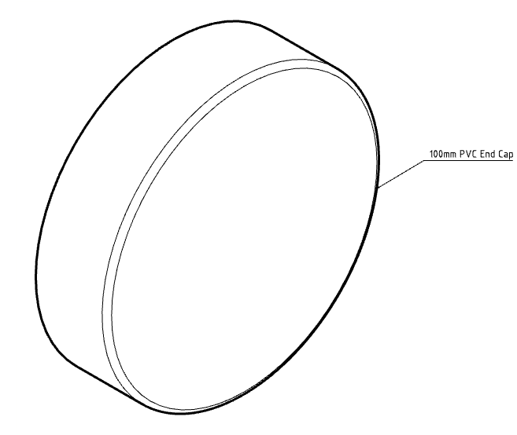
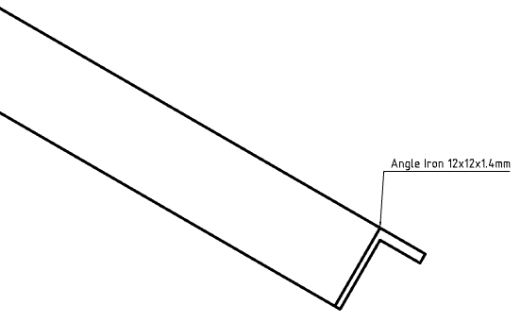

Slide 5
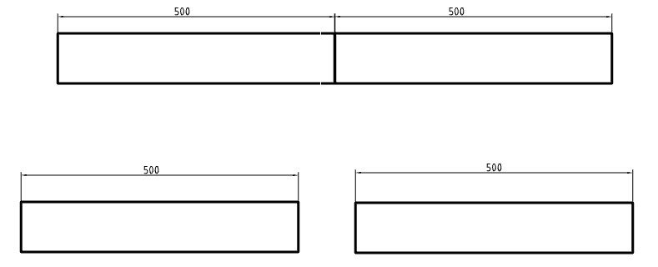
Step 1:
Measure and mark off 500mm from the end of the pipe. Then carefully cut through to make two equal lengths.

Slide 6
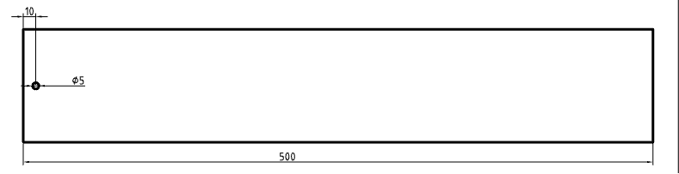
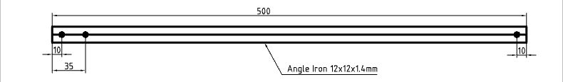
Step 2:
Drill a 5mm hole, 10mm from one end of the pipe. Rotate the pipe 90 degrees and repeat.
Step 3:
Drill three holes in the centre of the angle iron as shown here:
Notes:
Step two is a little difficult to communicate via drawing i.e. how to measure 90 degrees around the pipe. Can be done with a strip of paper fairly easily but how to draw this out?

Slide 7
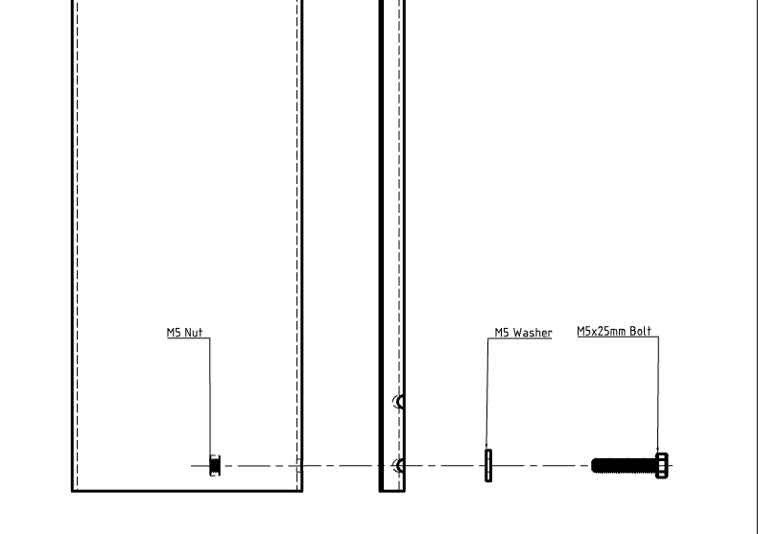
Step 4:
Loosely fasten the angle iron to the pipe using an M5 nut, bolt and washer.

Slide 8
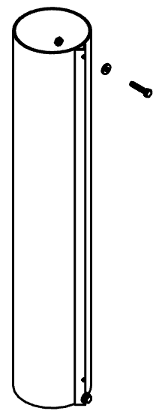
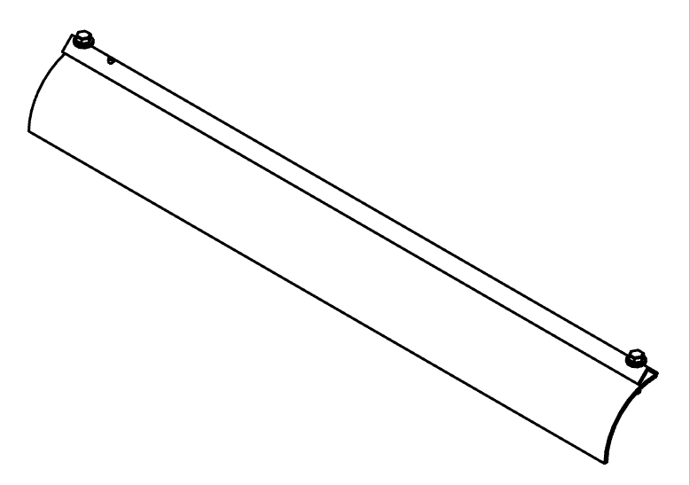
Step 5:
Lay the angle iron flat on the pipe so it makes a straight line down the length. Use the hole in the angle iron the drill a hole at the other end of the pipe and fasten down both ends securely.
Step 6:
Use the angle iron to make a straight cut down the pipe. Repeat this process until the pipe is in quarters.

Slide 9
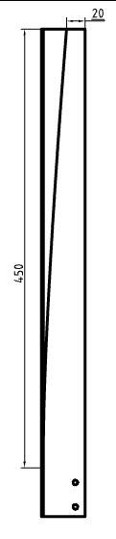

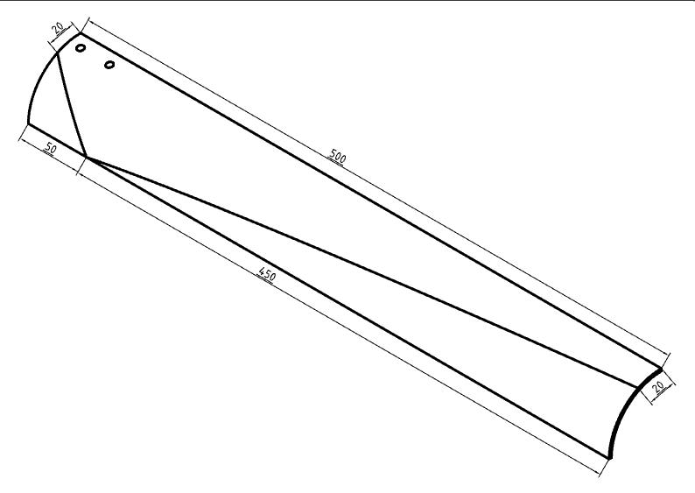
Step 7:
Measure the tip to be 20mm wide and then mark off a point 50mm from the other end. Join these two parts with a straight line and make a cut to shape the blade.
Repeat this process for the tip using the dimensions shown. Note that it is difficult to cut accurately due to the shape of the blades, and so it is recommended to cut less than you think and then use a file and sandpaper to finish.
Notes:
I think this is in the wrong order. Makes sense to cut the root first as it’s a smaller cut.

Slide 10
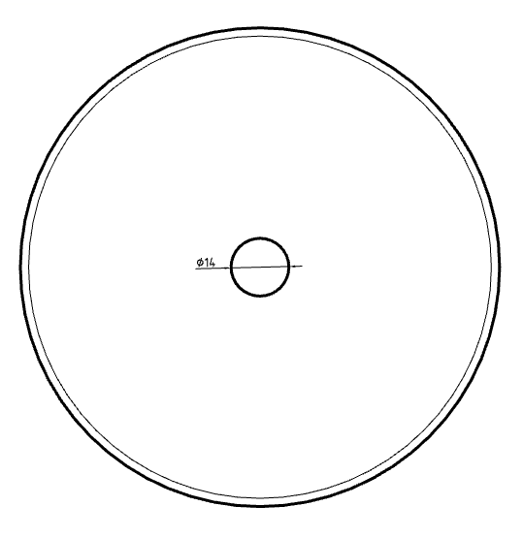
Step 8:
Find and mark off the centre of the 100mm PVC end cap. Use this mark to drill out a 14mm hole.
Notes:
Maybe some instruction on how to mark out the middle?
So it’s super easy with these because of the way they’re made (I think injection moulded), they have a little mark on the centre where a bit has been cut off.
I could give some detail on finding the centre of a circle but that’s a whole new set of instructions?

Slide 11
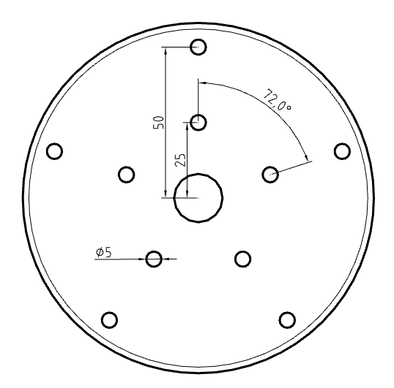
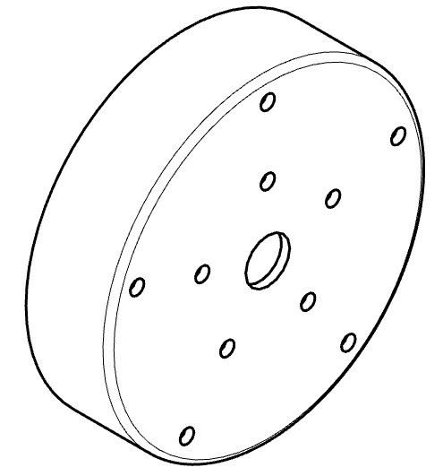
Step 9:
Drill out 5mm holes to attach the blades according to these dimensions.
Notes:
Def need some instruction on how you measured out these holes.
This was actually one of the things I was going to say can be printed. Drill the centre hole of the end cap and the 1:1 scale drawings and then line them up and drill through. Just hard to put into words but I’ll do it!

Slide 12
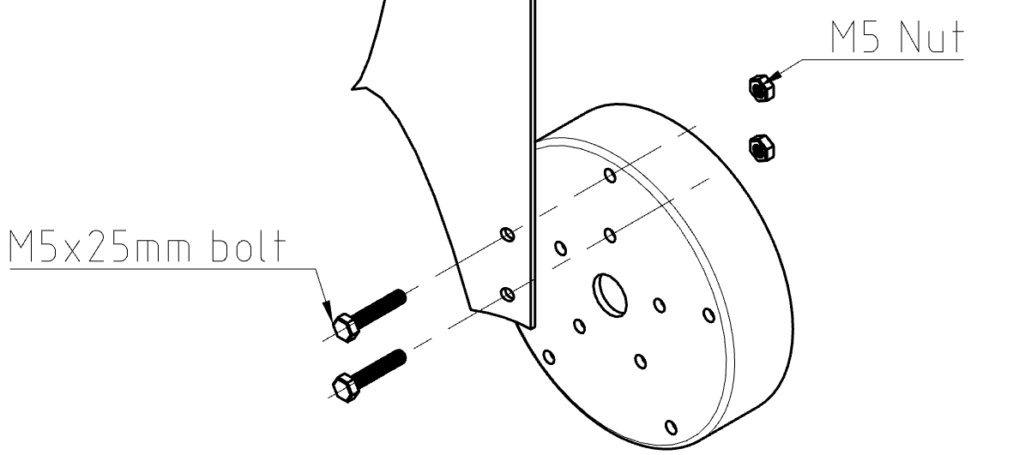
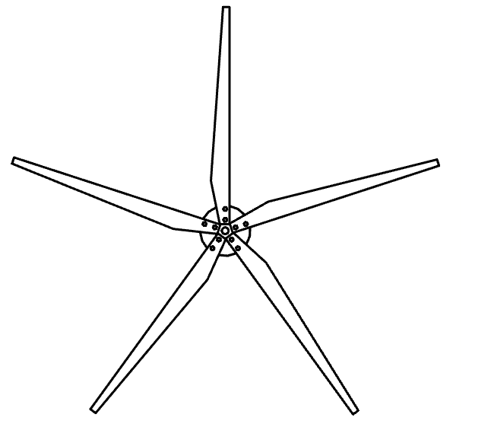
Step 12:
Attach each blade using 5mm bolts, washers and nylon locking nuts.
Notes:
This is beautiful.
This is how I imagine the rest of the instructions to look haha. Just surprisngly difficult to do with every step. Do you feel the side view is redundant?

Slide 13
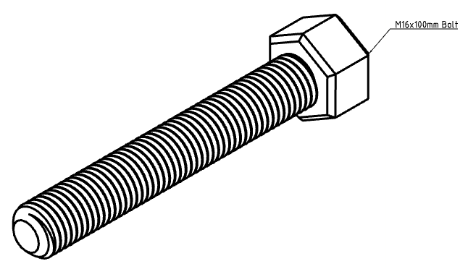
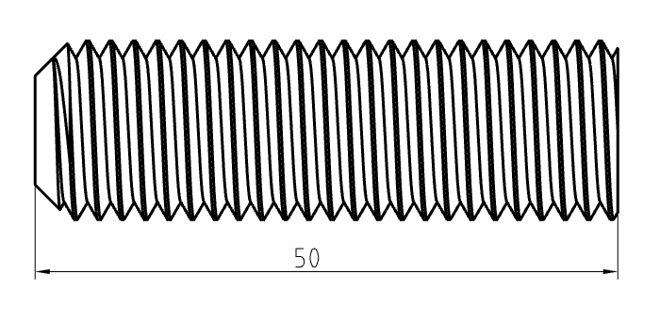
Step 13:
Cut off a 50mm length of the threaded shaft from an M16 bolt.
Notes:
How hard is it to make this vs finding a suitable part?
Still not sure I could find a suitable hub for my motor and this way allows some flexibility for motor shaft sizing. Having said that if we were to provide the motor we could try find a hub and provide with the motor?

Slide 14
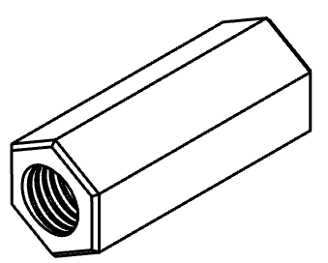
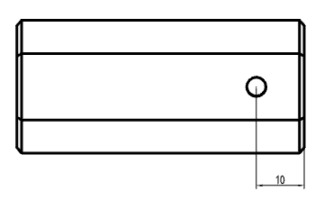
Step 14:
Drill a 4mm hole all the way through the M16 coupling, 10mm from one end.
Notes:
Add hole dimension to drawing
Add length dimension to view with hole
Add label to isometric view

Slide 15
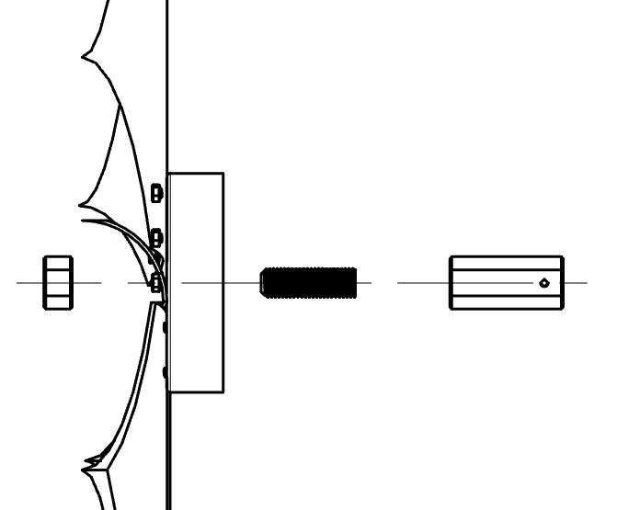
Step 15:
Fasten the whole blade assembly together, until really tight, using superglue or threadlock to hold the fasteners in place.

Slide 16
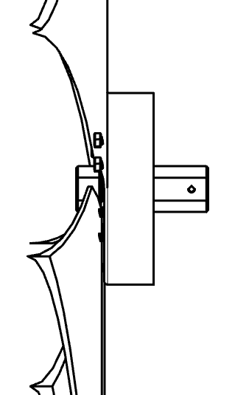
Marvel at your new blade assembly!
Notes:
Fantastic stuff dude. Really solid design and instructions.

